Slide 1
NUMPY

Slide 2
WHAT IS NUMPY AND WHY IT IS USED
Numpy is a library (many people confuse it with a module or framework but it's a library) that used for computing scientific/mathematical data. Other usages are in:
- Numerical Analysis - Linear algebra - Matrix computations
NumPy or Numeric Python is a package for computation on homogenous n-dimensional arrays. In numpy dimensions are called as axes.
INSTALL THE LIBRARY BY USING BELOW COMMANDS
conda install numpy
pip install numpy

Slide 3
WHY NEED NUMPY AT ALL?
A question arises that why do we need NumPy when python lists are already there. The answer to it is we cannot perform operations on all the elements of two list directly. For example we cannot multiply two lists directly we will have to do it element wise. This is where the role of NumPy comes into play.
list1 = [1, 2, 3, 4 ,5, 6]
list2 = [10, 9, 8, 7, 6, 5]
print(list1*list2)
BY USING NUMPY IT CAN BE DONE
import numpy as np
list1 = [1, 2, 3, 4, 5, 6]
list2 = [10, 9, 8, 7, 6, 5]
a1 = np.array(list1)
a2 = np.array(list2)
print(a1*a2)

Slide 4
Creating a Numpy Array
Arrays in Numpy can be created by multiple ways, with various number of Ranks, defining the size of the Array. Arrays can also be created with the use of various data types such as lists, tuples, etc. The type of the resultant array is deduced from the type of the elements in the sequences.
Type of array can be explicitly defined while creating the array.
# Python program for
# Creation of Arrays
import numpy as np
# Creating a rank 1 Array
arr = np.array([1, 2, 3])
print("Array with Rank 1: \n",arr)
# Creating a rank 2 Array
arr = np.array([[1, 2, 3], [4, 5, 6]])
print("Array with Rank 2: \n", arr)
# Creating an array from tuple
arr = np.array((1, 3, 2))
print(“\nArray created using “”passed tuple:\n”, arr)

Slide 5
Basic Array Operations
# Python program to demonstrate
# basic operations on single array
import numpy as np
# Defining Array 1
a = np.array([[1, 2],
[3, 4]])
# Defining Array 2
b = np.array([[4, 3],
[2, 1]])
# Adding 1 to every element
print ("Adding 1 to every element:", a + 1)
# Subtracting 2 from each element
print ("\nSubtracting 2 from each element:", b - 2)
# sum of array elements
# Performing Unary operations
print ("\nSum of all array "
"elements: ", a.sum())
# Adding two arrays
# Performing Binary operations
print ("\nArray sum:\n", a + b)

Slide 6
Data Types in Numpy
Every Numpy array is a table of elements (usually numbers), all of the same type, indexed by a tuple of positive integers. Every ndarray has an associated data type (dtype) object. This data type object (dtype) provides information about the layout of the array. The values of an ndarray are stored in a buffer which can be thought of as a contiguous block of memory bytes which can be interpreted by the dtype object. Numpy provides a large set of numeric datatypes that can be used to construct arrays. At the time of Array creation, Numpy tries to guess a datatype, but functions that construct arrays usually also include an optional argument to explicitly specify the datatype.

Slide 7
Constructing a Datatype Object
In Numpy, datatypes of Arrays need not to be defined unless a specific datatype is required. Numpy tries to guess the datatype for Arrays which are not predefined in the constructor function.
# Python Program to create
# a data type object
import numpy as np
# Integer datatype
# guessed by Numpy
x = np.array([1, 2])
print("Integer Datatype: ")
print(x.dtype)
# Float datatype
# guessed by Numpy
x = np.array([1.0, 2.0])
print("\nFloat Datatype: ")
print(x.dtype)
# Forced Datatype
x = np.array([1, 2], dtype = np.int64)
print("\nForcing a Datatype: ")
print(x.dtype)

Slide 8
Math Operations on DataType array
# Python Program to create # a data type object import numpy as np # First Array arr1 = np.array([[4, 7], [2, 6]], dtype = np.float64) # Second Array arr2 = np.array([[3, 6], [2, 8]], dtype = np.float64) # Addition of two Arrays Sum = np.add(arr1, arr2) print("Addition of Two Arrays: ") print(Sum) # Addition of all Array elements | # using predefined sum method Sum1 = np.sum(arr1) print("\nAddition of Array elements: ") print(Sum1) # Square root of Array Sqrt = np.sqrt(arr1) print("\nSquare root of Array1 elements: ") print(Sqrt) # Transpose of Array # using In-built function 'T' Trans_arr = arr1.T print("\nTranspose of Array: ") print(Trans_arr)

Slide 9
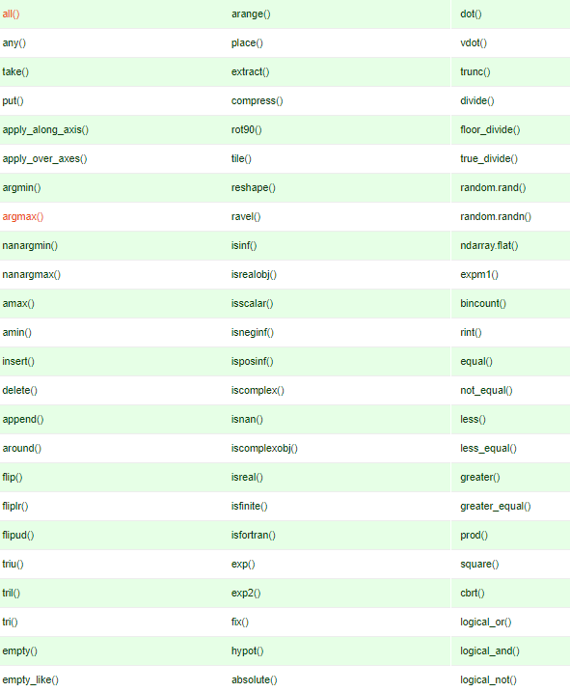
Methods in Numpy

Slide 10
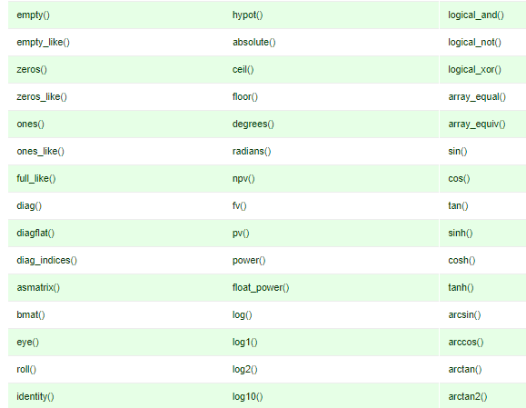

Slide 11

How to inspect the size and shape of a numpy array?
# Create a 2d array with 3 rows and 4 columns
list2 = [[1, 2, 3, 4],[3, 4, 5, 6], [5, 6, 7, 8]]
arr2 = np.array(list2, dtype='float')
arr2
#> array([[ 1., 2., 3., 4.],
#> [ 3., 4., 5., 6.],
#> [ 5., 6., 7., 8.]])
# shape
print('Shape: ', arr2.shape)
# dtype
print('Datatype: ', arr2.dtype)
# size
print('Size: ', arr2.size)
# ndim
print('Num Dimensions: ', arr2.ndim)

Slide 12
EXERCISE
How to extract specific items from an array?
How to reverse the rows and the whole array?

Slide 13
How to compute mean, min, max on the ndarray?
# mean, max and min
print("Mean value is: ", arr2.mean())
print("Max value is: ", arr2.max())
print("Min value is: ", arr2.min())
output
#> Mean value is: 3.58333333333
#> Max value is: 8.0
#> Min value is: -1.0

Slide 14
Predefined methods
Predicates
a.any(), a.all()
Reductions
a.mean(), a.argmin(), a.argmax(), a.trace(),
a.cumsum(), a.cumprod()
Manipulation
a.argsort(), a.transpose(), a.reshape(...),
a.ravel(), a.fill(...), a.clip(...)
Complex Numbers
a.real, a.imag, a.conj()

Slide 15
Some default functions
a = np.arange(6).reshape((2, 3)) //create a matrix array
a = np.arange(10) //range of values
a=np.zeros((2,2)) //2x2 0 matrix is created
a=np.ones((1,5)) //1x5 1 matrix is created
a= np.empty((1,3)) //uninitialized matrix of 1x3
A=np.eye(3) // diagonal matrix of 1 In format of 3x3 matrix
A=np.diag([1,2,3,4]) //diagonal matrix of having values in format of 4x4 matrix
Using random.rand(), we can generate an array of random numbers of the shape we pass to it from uniform distribution over 0 to 1
my_rand = np.random.rand(5, 4) my_rand
my_randn = np.random.randn(7)//provides the normal distribution curve

Slide 16
Universal Functions (ufuncs)
comparison: <, <=,==, !=, >=, >
arithmetic: +, -,*, /, reciprocal, square
exponential: exp, expm1, exp2, log, log10, log1p, log2,power, sqrt
trigonometric: sin, cos, tan, acsin, arccos, atctan
hyperbolic: sinh, cosh, tanh, acsinh, arccosh, atctanh
bitwise operations: &, |, ~,^, left_shift, right_shift
logical operations: and, logical_xor, not, or
predicates: isfinite, isinf, isnan, signbit
other: abs, ceil, floor, mod, modf, round, sinc, sign,trunc

Slide 17
Broadcasting in numpy
The term broadcasting refers to the ability of NumPy to treat arrays of different shapes during arithmetic operations. Arithmetic operations on arrays are usually done on corresponding elements. If two arrays are of exactly the same shape, then these operations are smoothly performed.
Broadcasting is a quick way to change the values of a NumPy array.
import numpy as np
a = np.array([1,2,3,4])
b = np.array([10,20,30,40])
c = a * b
print c
Output
[10 40 90 160]
If the dimensions of two arrays are dissimilar, element-to-element operations are not possible. However, operations on arrays of non-similar shapes is still possible in NumPy, because of the broadcasting capability. The smaller array is broadcast to the size of the larger array so that they have compatible shapes.

Slide 18
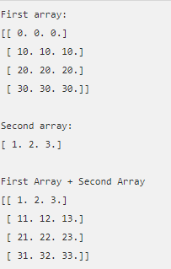
import numpy as np
a = np.array([[0.0,0.0,0.0],[10.0,10.0,10.0],[20.0,20.0,20.0],[30.0,30.0,30.0]])
b = np.array([1.0,2.0,3.0])
print 'First array:'
print a
print '\n'
print 'Second array:'
print b
print '\n'
print 'First Array + Second Array'
print a + b

Slide 19
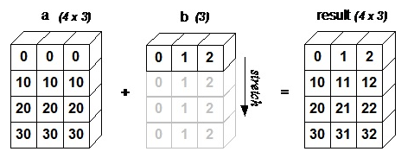
The following figure demonstrates how array b is broadcast to become compatible with a.

Slide 20
ARRAY MANIPULATION
Changing Shape
reshape()-Gives a new shape to an array without changing its data
flatten()-Returns a copy of the array collapsed into one dimension
flat()-A 1-D iterator over the array
ravel()-Returns a contiguous flattened array
Transpose Operations
Transpose()-Permutes the dimensions of an array
ndarray.T-Same as self.transpose()
Rollaxis()-rolls the specified axis backwards, until it lies in a specified position.
numpy.rollaxis(arr, axis, start)
swapaxes- interchanges the two axes of an array.
numpy.swapaxes(arr, axis1, axis2)

Slide 21
Changing dimensions
Sr.No. | Dimension & Description
1 | Broadcast Produces an object that mimics broadcasting
2 | broadcast to Broadcasts an array to a new shape
3 | Expand_dims Expands the shape of an array
4 | Squeeze Removes single-dimensional entries from the shape of an array

Slide 22
Joining Arrays
Sr.No. | Array & Description
1 | concatenateJoins a sequence of arrays along an existing axis
2 | Stack Joins a sequence of arrays along a new axis
3 | Hstack Stacks arrays in sequence horizontally (column wise)
4 | vstack Stacks arrays in sequence vertically (row wise)

Slide 23
Splitting Arrays
Sr.No. | Array & Description
1 | splitSplits an array into multiple sub-arrays
2 | hsplitSplits an array into multiple sub-arrays horizontally (column-wise)
3 | vSplit Splits an array into multiple sub-arrays vertically (row-wise)

Slide 24
Adding / Removing Elements
Sr.No. | Element & Description
1 | resizeReturns a new array with the specified shape
2 | appendAppends the values to the end of an array
3 | insertInserts the values along the given axis before the given indices
4 | deleteReturns a new array with sub-arrays along an axis deleted
5 | Unique Finds the unique elements of an array

Slide 25
Arithmetic operations
arr = np.arange(1,11)
arr * arr #Multiplies each element by itself
arr - arr #Subtracts each element from itself
arr + arr #Adds each element to itself
arr / arr #Divides each element by itself
universal functions such as square roots, exponentials, trigonometric, etc on array
np.sqrt(arr) #Returns the square root of each element
np.exp(arr) #Returns the exponentials of each element
np.sin(arr) #Returns the sin of each element
np.cos(arr) #Returns the cosine of each element
np.log(arr) #Returns the logarithm of each element
np.sum(arr) #Returns the sum total of elements in the array
np.std(arr) #Returns the standard deviation of in the array

Slide 26
grab the sum of columns or rows in a 2-d array:
mat = np.arange(1,26).reshape(5,5)
mat.sum() #Returns the sum of all the values in mat
mat.sum(axis=0) #Returns the sum of all the columns in mat
mat.sum(axis=1) #Returns the sum of all the rows in mat

Slide 27
Indexing an array
Indexing is used to obtain individual elements from an array, but it can also be used to obtain entire rows, columns or planes from multi-dimensional arrays.
Indexing in 1 dimension
We can create 1 dimensional numpy array from a list like this:
import numpy as np
a1 = np.array([1, 2, 3, 4])
print(a1) # [1, 2, 3, 4]
We can index into this array to get an individual element, exactly the same as a normal list or tuple:
print(a1[0]) # 1
print(a1[2]) # 3

Slide 28
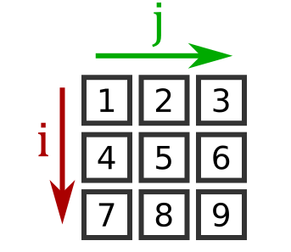
Indexing in 2 dimensions
We can index an element of the array using two indices - i selects the row, and j selects the column:
import numpy as np
a2 = np.array([[1, 2, 3],
[4, 5, 6],
[7, 8, 9]])
print(a2[2, 1]) # 8

Slide 29
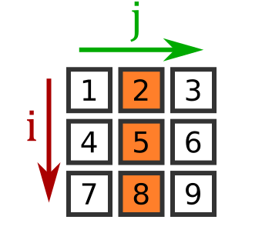
Picking a row or column
However, numpy allows us to select a single columm as well:
print(a2[:, 1]) # [2, 5, 8]
for the i value, take all values (: is a full slice, from start to end)
for the j value take 1

Slide 30
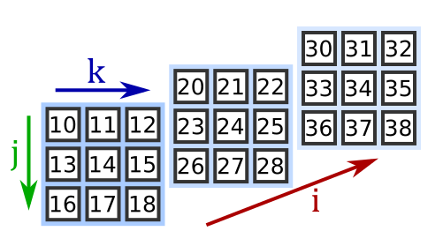
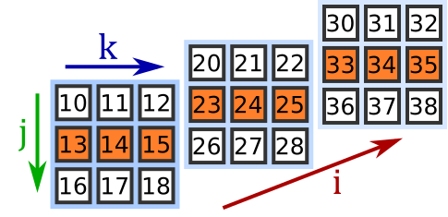
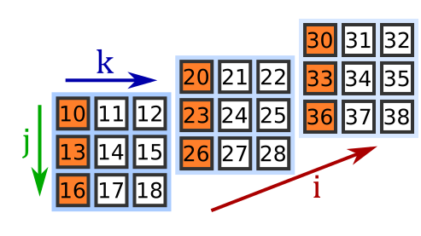
Indexing in 3 dimensions
import numpy as np
a3 = np.array([[[10, 11, 12], [13, 14, 15], [16, 17, 18]], [[20, 21, 22], [23, 24, 25], [26, 27, 28]], [[30, 31, 32], [33, 34, 35], [36, 37, 38]]])
Here is how to index a particular value in a 3D array: (i,k,j)
print(a3[2, 0, 1]) # 31
Picking a row or column in a 3D array
print(a3[0, :, 1]) # [11 14 17]
Picking a matrix in a 3D array print(a3[:, 1]) # [[13 14 15]
# [23 24 25]
# [33 34 35]]
print(a3[:, :, 0]) # [[10 13 16]
# [20 23 26]
# [30 33 36]]

Slide 31
Slicing an array
You can slice a numpy array is a similar way to slicing a list - except you can do it in more than one dimension.
As with indexing, the array you get back when you index or slice a numpy array is a view of the original array. It is the same data, just accessed in a different order. This is different to lists, where a slice returns a completely new list.
Slicing lists
a = [10, 11, 12, 13, 14]
b = a[1:4] # [11, 12, 13]
c = a[:3] # [10, 11, 12]
d = a[2:] # [12, 13, 14]
e = a[:] # [10, 11, 12, 13, 14]

Slide 32
Slicing 1D numpy arrays
import numpy as np
a1 = np.array([1, 2, 3, 4, 5])
b = a1[1:4]
print(b) # [2, 3, 4]
The only thing to remember if that (unlike a list) a1 and b are both looking at the same underlying data (b is a view of the data). So if you change an element in b, a1 will be affected (and vice versa):
b[1] = 10
print(b) # [2, 10, 4]
print(a1) # [1, 2, 10, 4, 5]

Slide 33
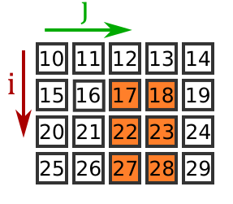
Slicing a 2D array
You can slice a 2D array in both axes to obtain a rectangular subset of the original array. For example:
import numpy as np
a2 = np.array([[10, 11, 12, 13, 14],
[15, 16, 17, 18, 19],
[20, 21, 22, 23, 24],
[25, 26, 27, 28, 29]])
print(a2[1:,2:4]) # [[17 18]
# [22 23]
# [27 28]]
This selects rows 1: (1 to the end of bottom of the array) and columns 2:4 (columns 2 and 3), as shown here:

Slide 34
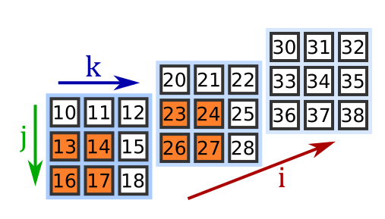
Slicing a 3D array
import numpy as np
a3 = np.array([[[10, 11, 12], [13, 14, 15], [16, 17, 18]],[[20, 21, 22], [23, 24, 25], [26, 27, 28]],[[30, 31, 32], [33, 34, 35], [36, 37, 38]]])
print(a3[:2,1:,:2]) # [[ [13 14] [16 17] ]
# [ [23 24] [26 27] ]]
This selects:
planes :2 (the first 2 planes)
rows 1: (the last 2 rows)
columns :2 (the first 2 columns)

Slide 35
Full slices
to select all planes, columns or rows. However, for trailing indices, simply omitting the index counts as a full slice. So for 2D arrays
a2[1:3,:] # is the same as a2[1:3]
For 3D arrays:
a3[1:,:2,:] # is the same as
a3[1:,:2]
a3[1:,:,:] # is the same as
a3[1:,:] # and is also the same as
a3[1:]

Slide 36
Slices vs indexing
As we saw earlier, you can use an index to select a particular plane column or row. Here we select row 1, columns 2:4:
import numpy as np
a2 = np.array([[10, 11, 12, 13, 14],[15, 16, 17, 18, 19],[20, 21, 22, 23, 24], [25, 26, 27, 28, 29]])
print(a2[1,2:4]) # [17 18]
You can also use a slice of length 1 to do something similar (slice 1:2 instead of index 1):
print(a2[1:2,2:4]) # [[17 18]]
Notice the subtle difference. The first creates a 1D array, the second creates a 2D array with only one row.

